Slide 1
Cloud and Cognitive Software
Driving purposeful innovation and transformational change

Slide 2

Transformation is a journey.
What’s your
next step?

Slide 3
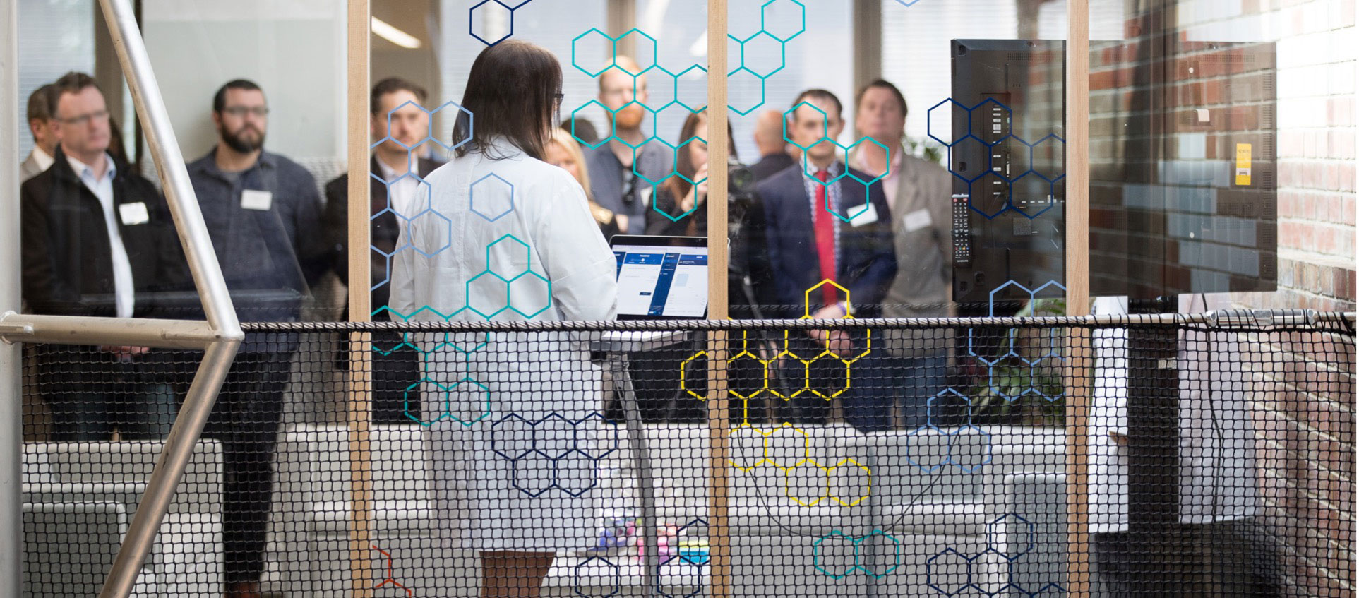
Guided transformation inspires
smart and confident decisions
Transform
Establish new areas of innovation and creativity.
Enhance customer experiences.
Improve company-wide performance.
Establish a hypothesis-driven culture.
Collect and use data to increase productivity and, with it, revenue.
Transformation involves adopting cloud and analytics, and perhaps IoT, AI, quantum, and beyond.
Transformation is more than just adopting technology.
decision
making
with
technology
  Get fast, tangible outcomes and deliverables.
  Expand your teams’ expertise.
  Use new frameworks, new ways of working, and new thinking to establish lasting change and long-term skills.

Slide 4
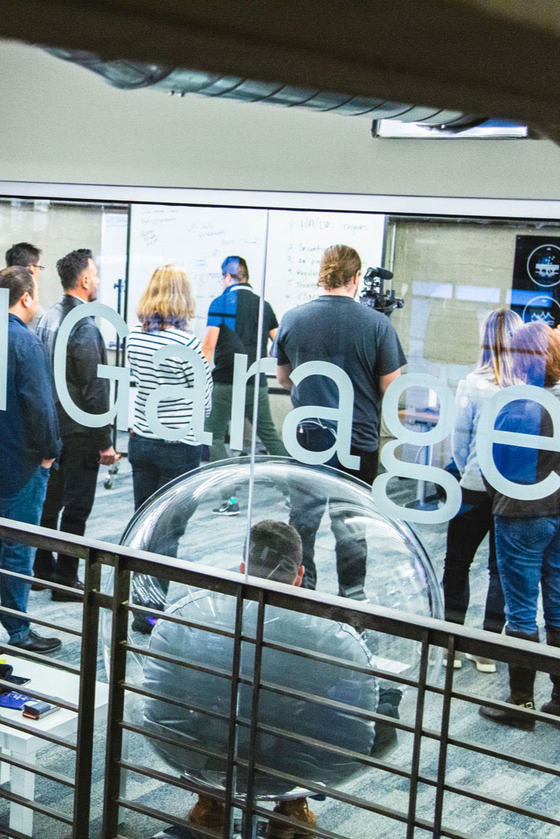
Your next, first step to be first,
move fast, go farther.
No matter your interest…
AI
Analytics
Automation
Big Data
Blockchain
Data Science
Design
DevOps
IoT
Microservices
Multi-cloud
Private Cloud
Quantum
Security
IBM Garage
provides you
Business knowledge
Strategy execution
Technical expertise
Meanwhile, your team adopts a new way of working, from start to finish.

Slide 5
What makes a
Garage?

Slide 6





Take your idea to reality with speed.
Activities
Initial Framing Session |  | Design Thinking |  | Architecture |  | Minimum Viable Product Build-up |  | Build Out
Client outcomes
Align on your vision and desired business outcome. Confirm executive sponsor, product owner. |  | Align LOB and IT on user experience and roadmap to meet your vision. Agree on next MVP business experiment. |  | Assess and align minimum viable architecture. |  | Test hypothesis via learning–driven production release. Achieve the stated business mission. |  | Become self–sufficient in achieving business results with the IBM Garage Method. Scale production environment/app.
Applies to: Innovation | Modernization | Data & AI | and more

Slide 7




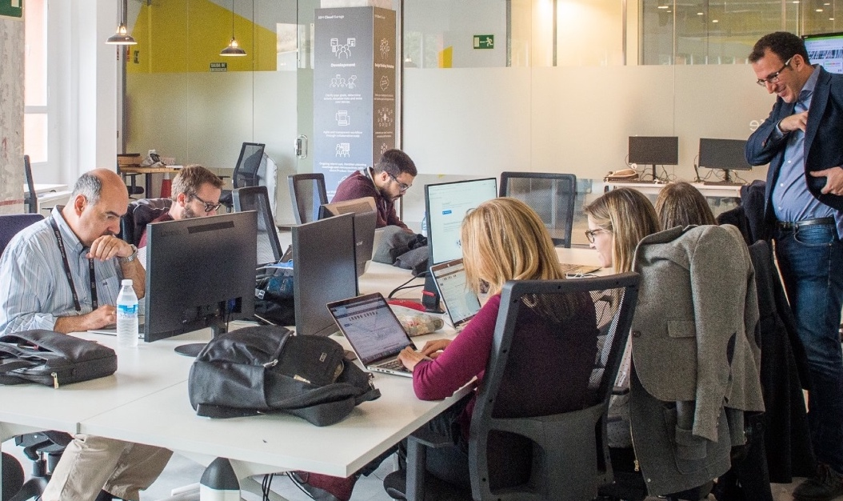
Foundations of the IBM Garage
People and capabilities |  | Applied technology |  | New ways of working |  | Global network |  | Partnerships
Your team, our team, and an ecosystem of expertise customized to the opportunity: Designers Architects Developers IBM Research Industry experts Digital strategists Data scientists Process specialists |  | A catalog of workflows powered by: Hybrid Cloud AI and Automation Data science, Analytics Blockchain Technology integration AR/VR IoT Quantum |  | Inspire and adopt a new way of working designed for the digital era: Enterprise Design Thinking Agile, Distributed agile Site reliability engineering DevOps Digital change Lean startup Transformation framework |  | Our workspaces inspire ideas and enable change: Purpose-built, worldwide IBM Garages Client or third-party locations including IBM Studios, IBM Delivery Hubs Innovation platform Local capability leveraged globally and consistently |  | Leverage our ever-expanding ecosystem of partners across the world. As your transformation matures, our guidance extends beyond your innovation.

Slide 8
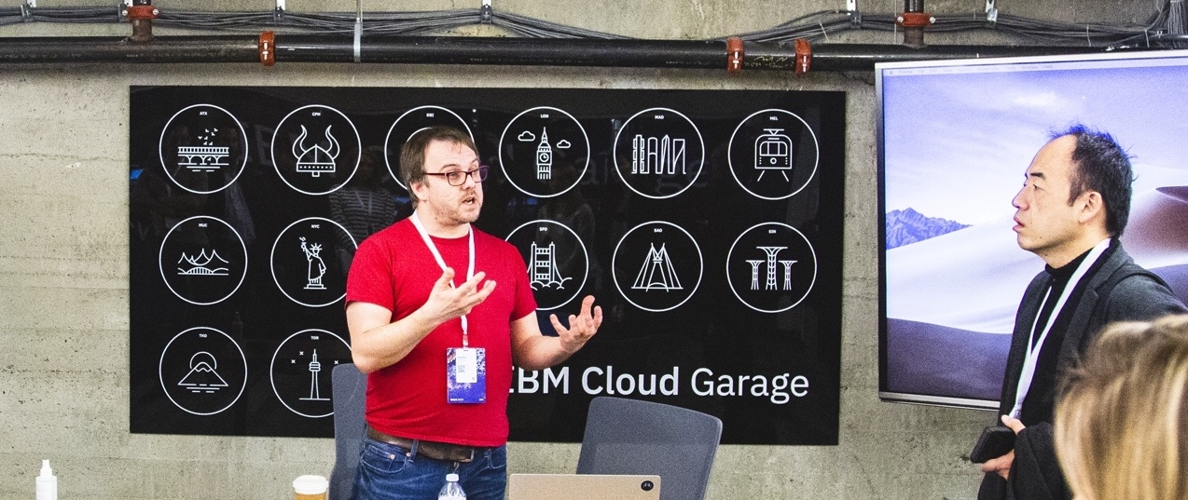
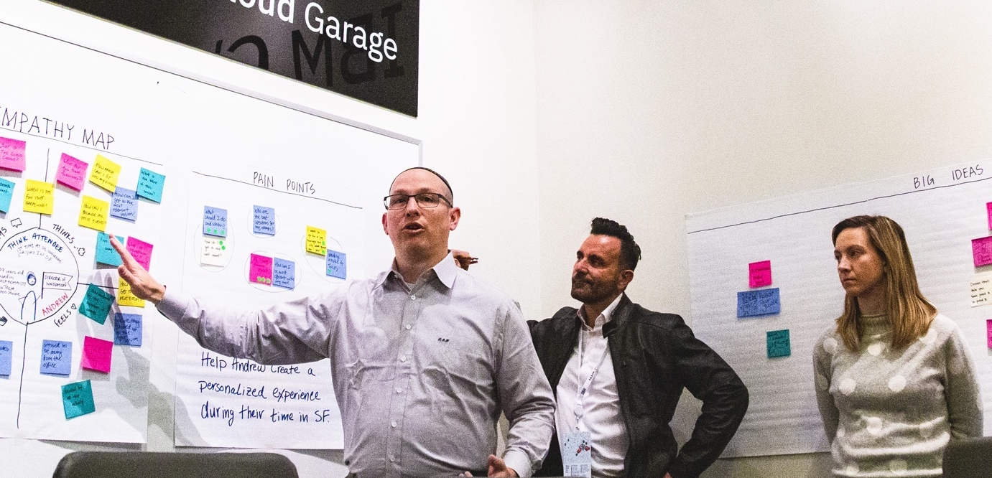

The IBM Garage experience
IBM Garage Visit with Initial Framing Session
Design Thinking Workshop
MVP
Build-up
Experience our innovation spaces
See first-hand how your business can be transformed.
Frame your business issues as opportunities to test.
Validate as a path to business transformation.
Align your business and technical leadership around your big idea.
Define your vision before turning it into reality.
Outline how you will measure success establish your hypothesis.
Test your hypothesis and measure real minimum viable product (MVP) outcomes against your goals.
Rapidly iterate on your chosen idea to build production-ready code you can use.

Slide 9

Are you ready to take the next step?

Slide 10
Hear from
Our clients

Slide 11

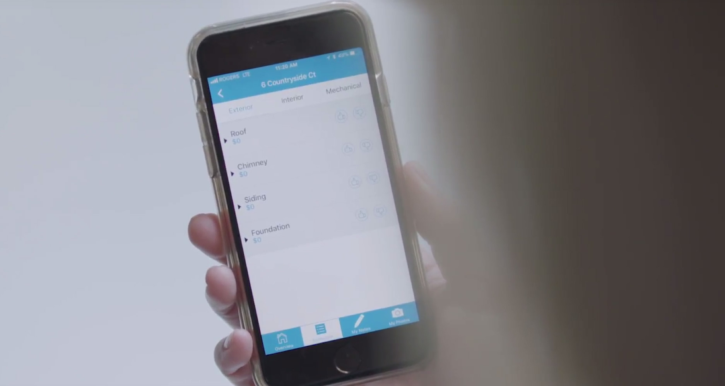
“Having the confidence to just flip the switch really came out of the whole project from the beginning. This was a unique opportunity for us to embed the business side with the technology team.”
Julie Rath
Managing Director, Customer Service Recovery
American Airlines
Click to watch
American Airlines
video story
“This innovation experience with Design Thinking and Minimum Viable Product, and being able to build an ecosystem in the IBM Cloud in a six-week period has changed everything.”
Carol Poulsen
Executive Vice-President & Chief Information Officer
The Co-Operators
Click to watch
The Co-Operators
video story

Slide 12

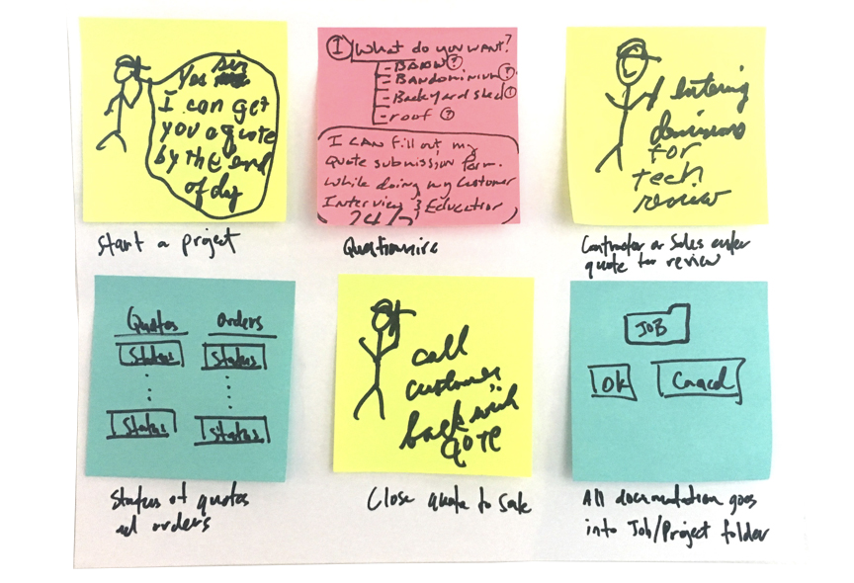
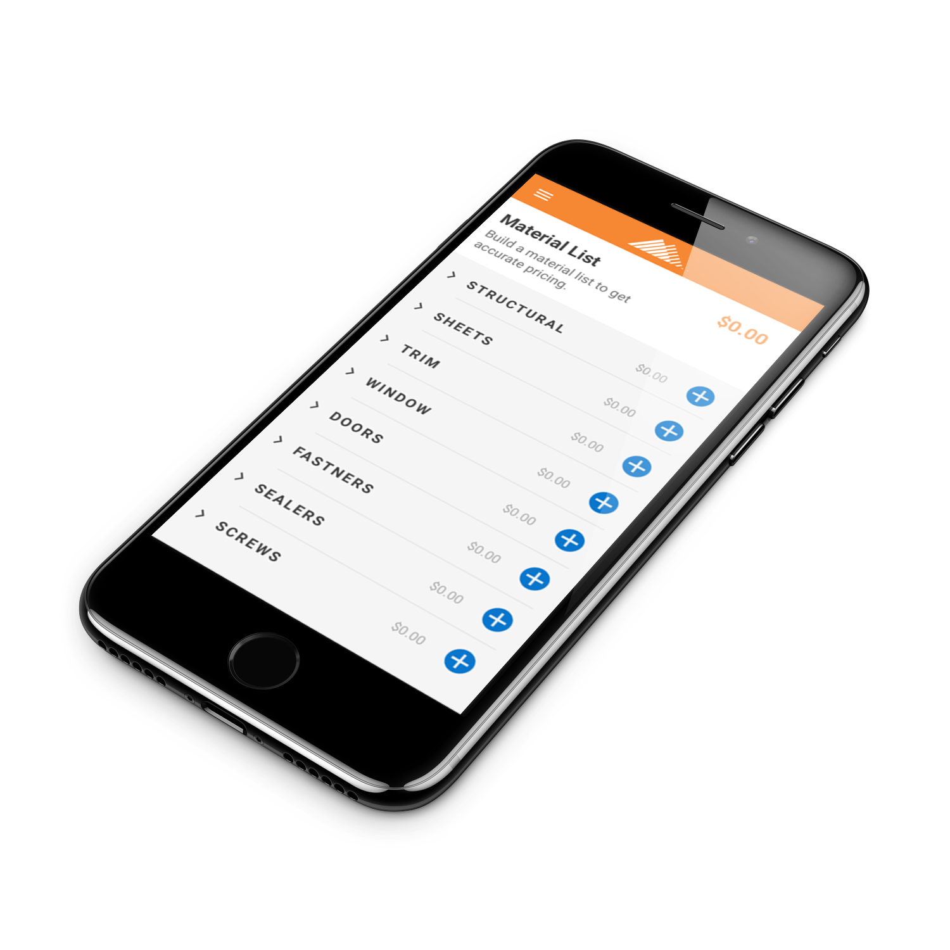
As Mueller, Inc., a manufacturer and retailer of steel building products in the United States, watched sales skyrocket, its contractors were stretched thin — ordering from Mueller buried them in paperwork.
To minimize the time contractors spent on administrative tasks and gain consensus on a solution, Mueller partnered with the IBM Garage because it offers expertise in deep data, cloud and strategic workshops.
Using the IBM Garage Method for Cloud, the IBM Garage team spent a week interviewing contractors in the field, then led a Design Thinking Workshop for Mueller’s leadership team at the IBM Garage in Austin.
In eight weeks, Mueller and the IBM Garage built a minimum viable product (MVP): an app, built on the IBM Cloud, that allowed contractors to submit building specifications and instantly receive a guaranteed pricing quote.
The MVP was tested with contractors, and 82 percent reported they would use the app at least once per week. Immediately after going live on the IBM Cloud, orders started coming in and Mueller’s contractors got back to doing what they do best: building clients’ dreams.

Slide 13

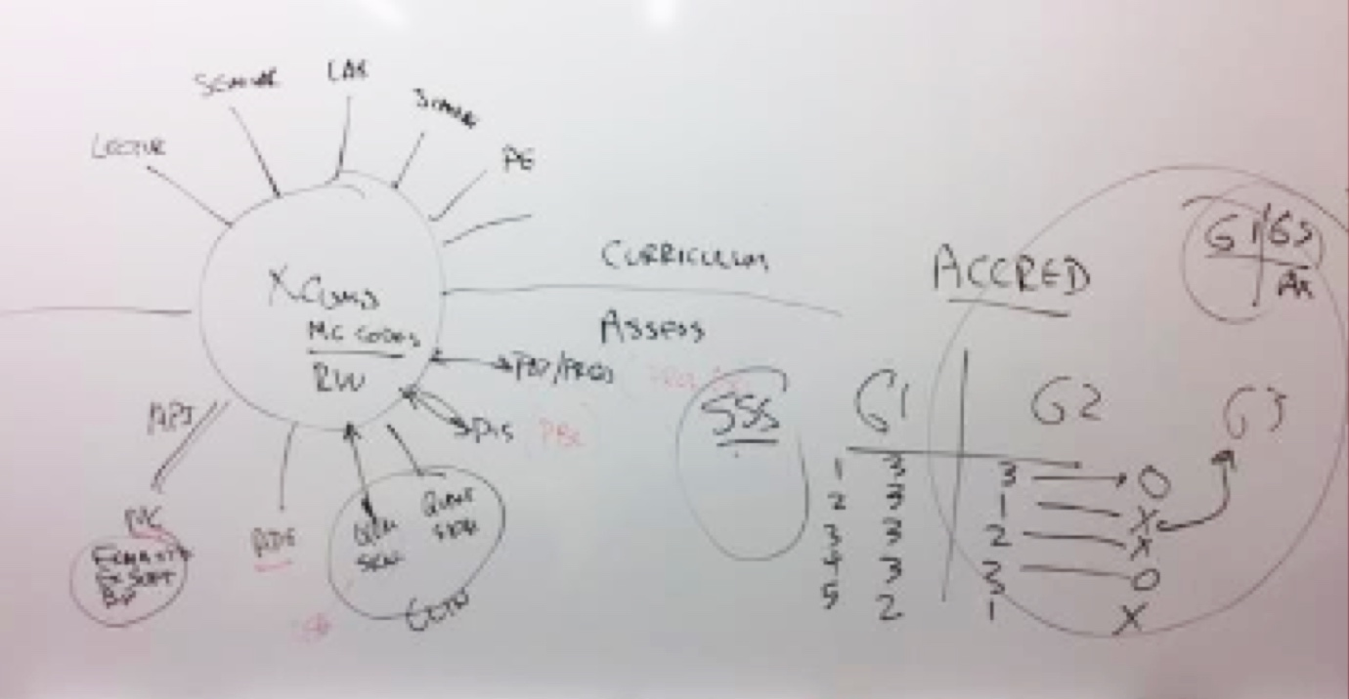
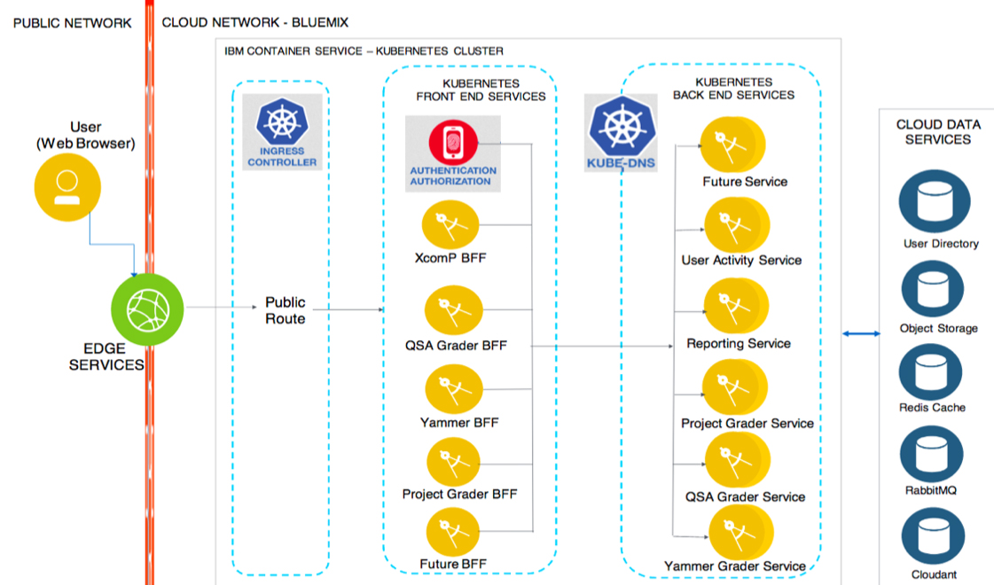
XComP Analytics, Inc., a technology startup company, was formed to commercialize an app developed by East Carolina University. Its XComP (eXtensible Competencies Platform) system helps assess student outcomes by generating real-time evaluations.
XComP was concerned its assessment system was throwing away usable data. In addition, XComP needed to modernize its original concept into a common platform to enhance data insights and reporting, but didn’t know where to start.
In an IBM Design Thinking workshop, XComP and IBM Garage experts used the IBM Garage Method for Cloud to evaluate the XComP system. The team focused on user-centered design and agile development to discover a better application architecture on IBM Cloud.
The IBM Garage and XComP built a minimum viable product (MVP) on IBM Cloud, separating the system into microservices with analytics capabilities. During its successful modernization of the platform, the team also discovered a hierarchy of MVPs that it could build in the future.
XComP now uses thousands of pieces of data, including previously unused data, to better predict student performance and improve the educational ecosystem. XComP plans to continue partnering with the IBM Garage to realize the full potential of the discoveries made during the engagement.

Slide 14
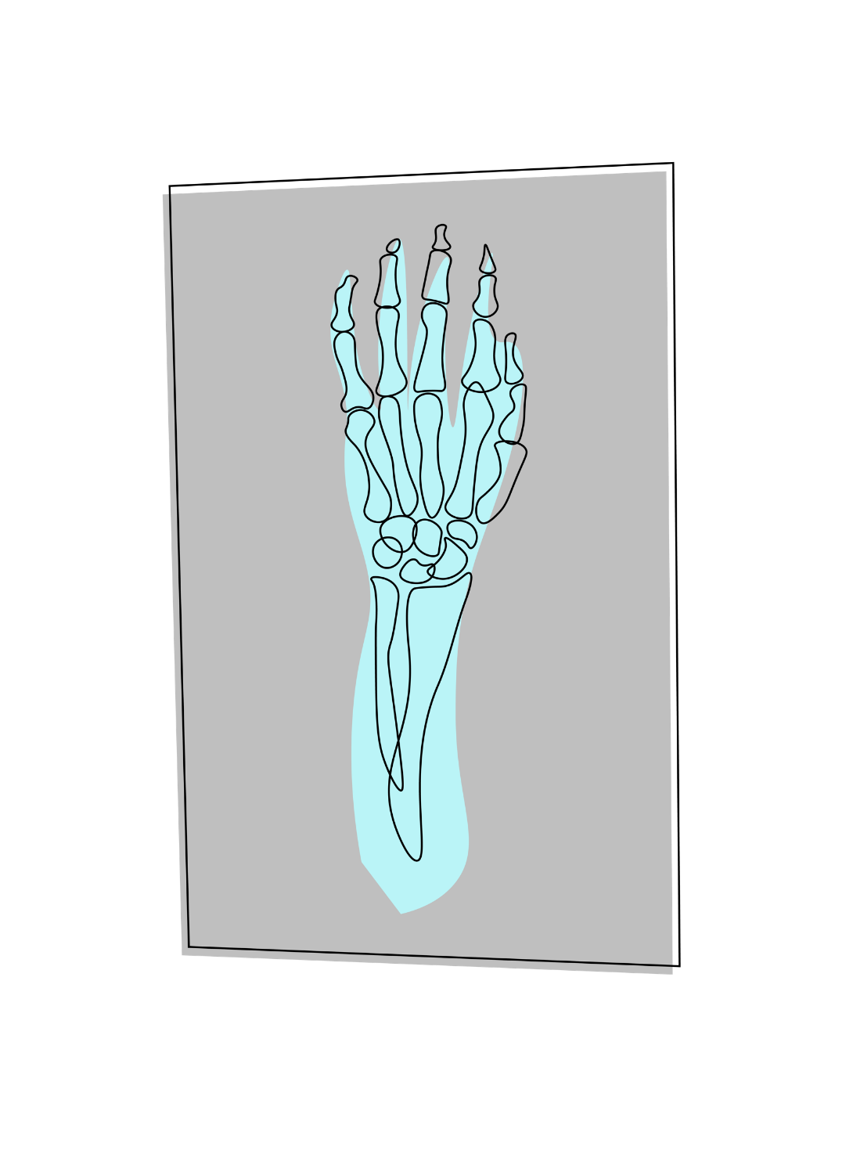
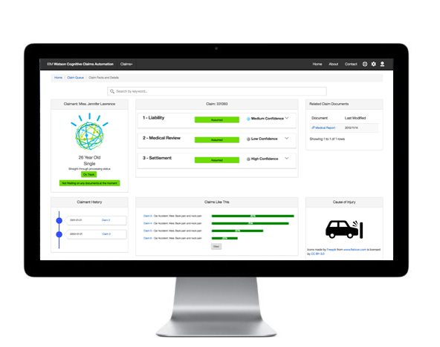
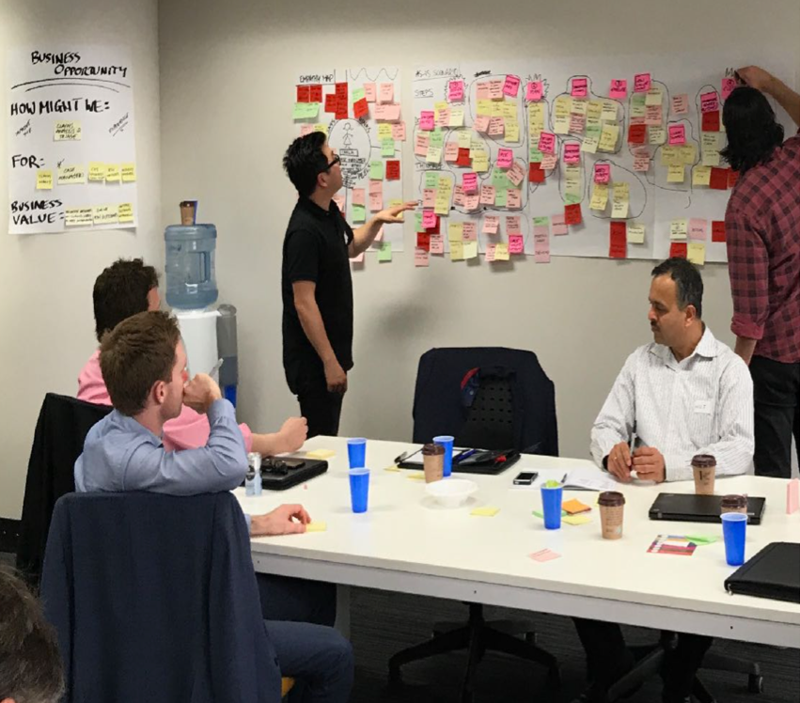
Overseeing up to 5,000 insurance claims a year for the Victoria, Australia government, DXC Xchanging, a business process service provider, wanted to help injured employees get better and return to work sooner.
DXC Xchanging partnered with the IBM Garage to help design a solution that allows case managers to triage claims, identify risky claims, focus resources and tailor services to the injured workers who need extra support.
Following the IBM Garage Method for Cloud, the IBM Garage team in Melbourne and DXC worked on a minimum viable product (MVP) using IBM SPSS software and the IBM Watson Studio platform to analyze 10 years of data from workers’ compensation claims.
To predict an injured employee’s time away from work, the team deployed models on the IBM Cloud through the IBM Watson Machine Learning service, and used IBM Db2 software to generate an injury’s most likely treatment plan and cost.
After a four-week MVP build, DXC Xchanging confirmed that with a predictive confidence around 80 percent, the IBM solution provided ample value to justify pursing a pilot of the solution and extending it to other insurance applications.

Slide 15















Find us worldwide
Connect
with us
Visit
San Francisco | Nice | New York | Tokyo | Austin
ibm.com/garage
Chat
garage@us.ibm.com
Copenhagen | Munich | Raleigh | Madrid | São Paulo
Dubai | Melbourne | Singapore | Toronto | London

Slide 17

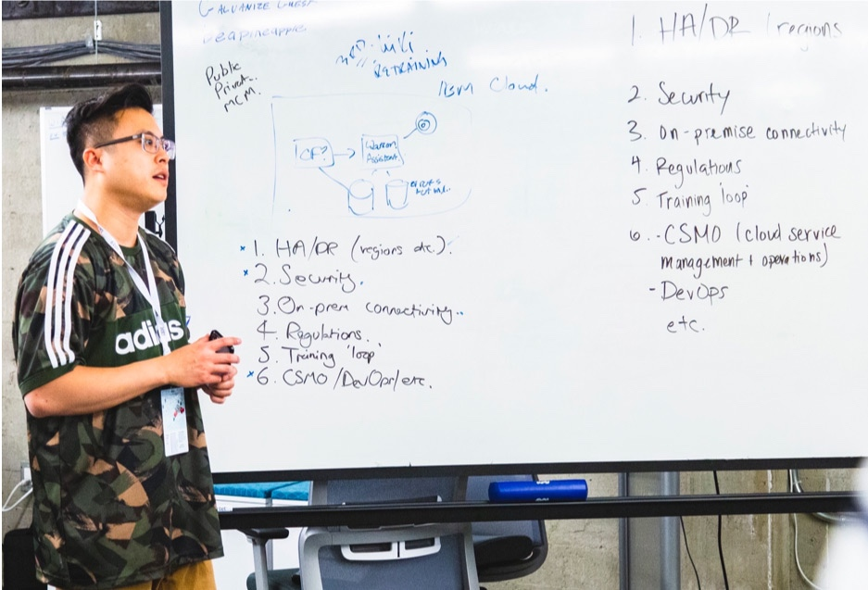

Let the IBM Garage Method for Cloud
elevate the way you work.
Use the IBM Garage Method for Cloud
to enable business, development, and operations to continuously design, deliver, and validate new function.
The Method combines best of class industry methods, plus our own deep experience and IBM methods, informed by thousands of client engagements.
Enterprise Design Thinking
Focus on user outcomes Empower diverse teams Reinvent restlessly
Lean Startup
Test assumptions Define a hypothesis Develop a Minimum Viable Product (MVP) Measure success Continuously collect feedback
Cloud Native Practices
Adopt DevOps Develop collaboratively Apply Pair Programming Use Test Driven Development (TDD) Continuously deploy code

