Slide 1
Scopia Elite 6000 Next Generation Hybrid MCU
Yaniv Levi
Director, Infrastructure Product Management

Slide 2
Video Conferencing Working Modes
VC Working Points
Premium
Group
Desktop/Mobile

Slide 3
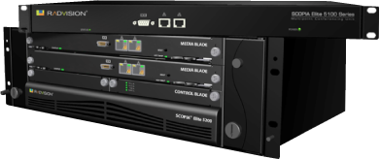
Video Conferencing Working Modes
Scopia Elite 5000
(Launched 2009)
VC Working Points
Premium
Group
Desktop/Mobile
1080p30
720p30
360p

Slide 4
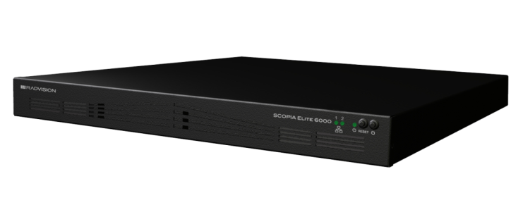
Introducing…
SCOPIA Elite 6000
…what’s new?
Notes:
Save BW
3 working points:

Slide 5
Performance
Scopia Elite 5000
(Launched 2009)
Scopia Elite 6000
(Launched 2013)
VC Working Points
Premium
Group
Desktop/Mobile
1080p30
1080p60 HiP
720p30
1080p30 HiP
720p60 HiP
360p
480p HiP
2X

Slide 6
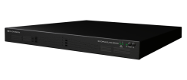
Density
Elite 5000
1080p/1U: 7
720p/1U: 15
Elite 6000
1080p/1U: 40
720p/1U: 80
5X
Notes:
Save BW
3 working points:

Slide 7
Summary
Performance
Density
2X
5X
how??
Notes:
Save BW
3 working points:

Slide 8
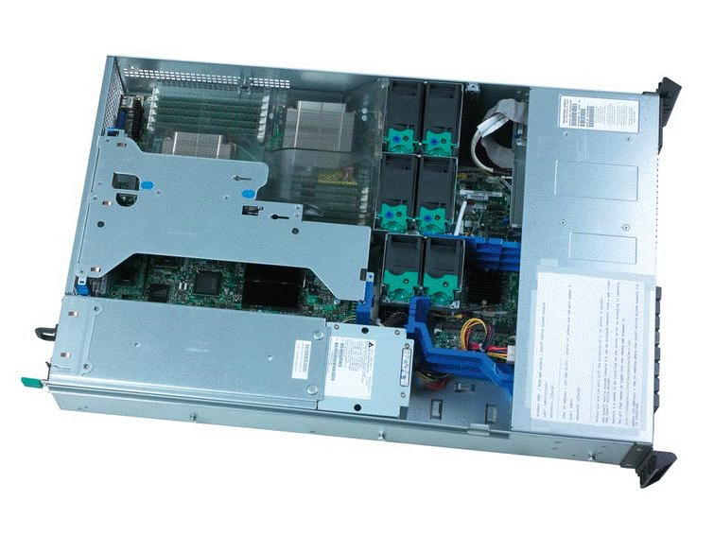
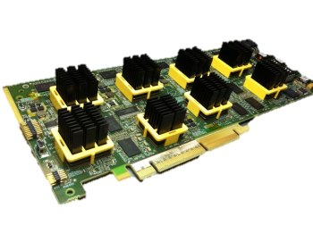
Scopia Elite 6000 - Hybrid MCU
Intel based Architecture
PCIe video accelerator blades
Notes:
Save BW
3 working points:

Slide 9
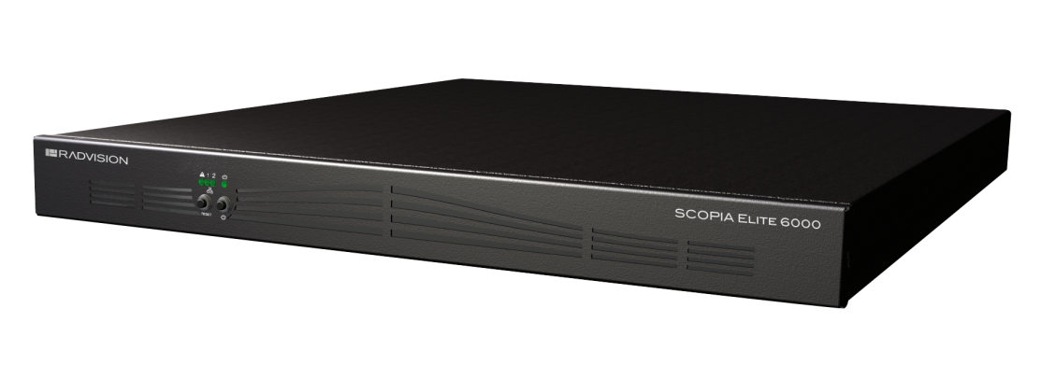
Scopia Elite 6000 Product Line
 | 1080p60 | 1080p30 or 720p30/60 | 720p30 (License Option) | 480p30
Elite 6105 | 3 | 5 | 10 | 20
Elite 6110 | 5 | 10 | 20 | 40
Elite 6120 | 10 | 20 | 40 | 80
Elite 6140 | 20 | 40 | 80 | 160

Slide 10
Scopia Elite 6140 – Capacity Example
Basic Product
License Option
Premium1080p60
20
Group
1080p30
40
Group 720p30
40
40
Desktop/Mobile
480p
160
40
80
160
Notes:
Save BW
3 working points:

Slide 11
Elite 6000 Feature Introduction Plan

Slide 12
Elite 6000 Phased Release Plan
V8.0 Jan 2013
V8.0.1 Mar 2013
720p and 480p Enhanced Capacity
V8.2 CYQ3 2013
H.264 SVC & High Profile
Dynamic Capacity MCU
Additional Features to Close on Elite 5000 Parity
1080p/60
Fixed Capacity MCU
High Density
Notes:
We could not fully develop all of the features in the Elite 5000 onto the Elite 6000 until Q3. We could have waited to release the Elite 6000 until it had full feature parity with the Elite 5000 and done a market replacement announcement however there are several key features that the Elite 6000 can deliver today and fill specific market requirements such as 1080p/60, H.264 HP and high density. So we will introduce the 6000 for those requirements and position it into sales situation that require them.

Slide 13
Fixed Capacity Vs Dynamic Capacity
1st call – 1080p60
1080p60
2nd call – 720p30
1080p30
3rd call – 1080p30
720p30
4th call – 480p30
480p
5th call – 1080p60
All calls consume the same resource
Each call consumes the exact resource needed
Elite 6110 – Fixed Capacity
CQ1’2013
Elite 6110 – Dynamic Capacity
CQ3’2013
Notes:
Save BW
3 working points:

Slide 14
True Symmetric 1080p60 Solution Live and Content

Slide 15
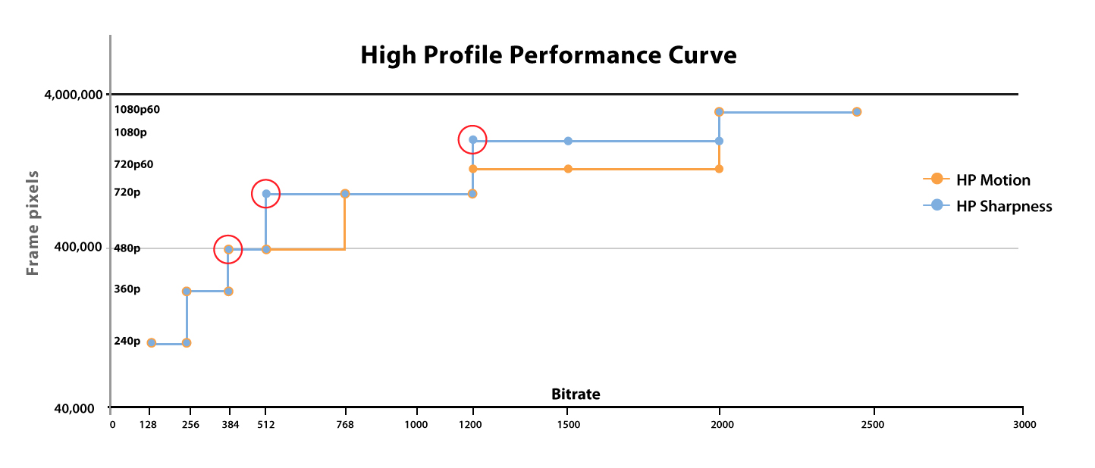
H.264 High-Profile
Efficient use of network resources
Fully interoperable
30-50% bandwidth saving
Notes:
Save BW
3 working points:

Slide 16
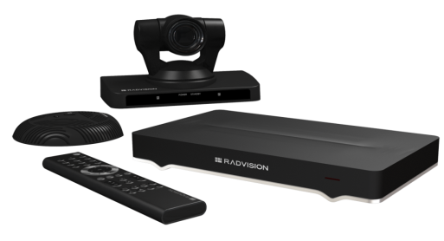
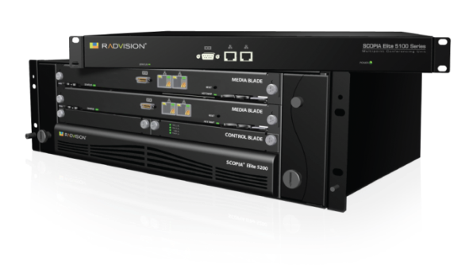
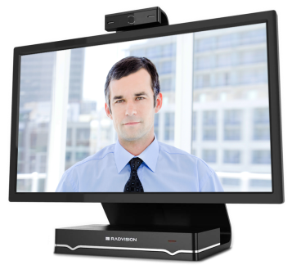
H.264 SVC Across the Board
SVC
1st
Comprehensive SVC Solution

Slide 17
Investment Protection
Works in conjunction with Elite 5000
Seamless & automatic, SVC-based cascading
Interoperable with existing devices

Slide 18
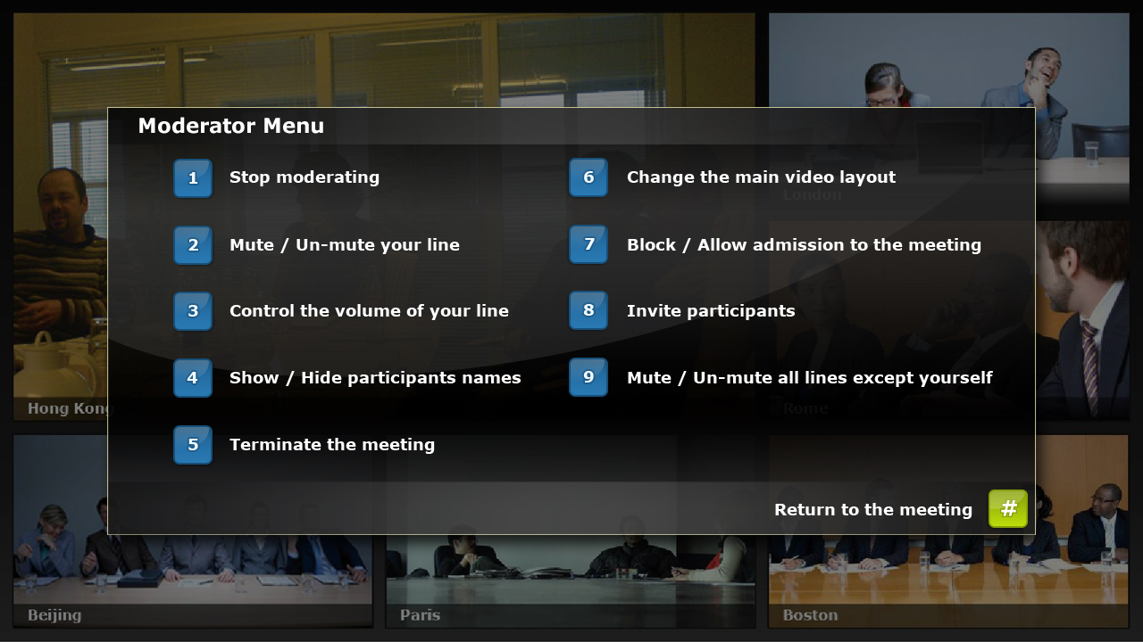
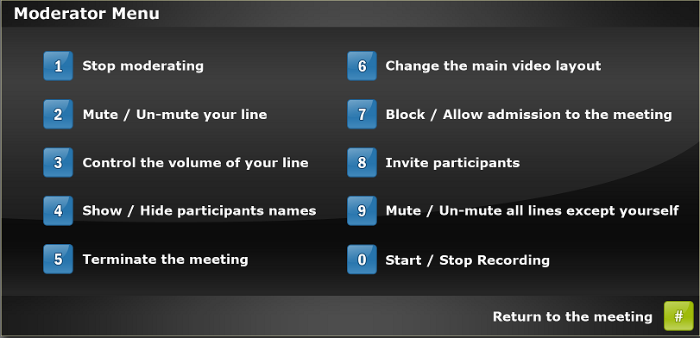
The Scopia Experience Rich User Experience

Slide 19
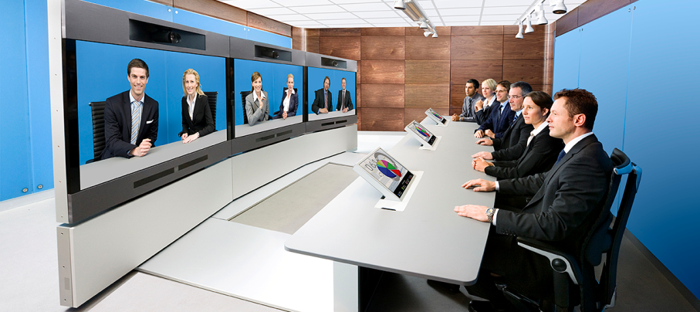
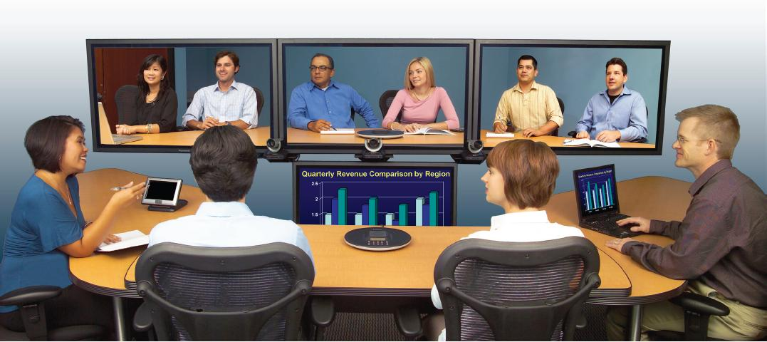
The Scopia Experience Telepresence Connectivity Included
Polycom
Cisco
Tandberg
LifeSize

Slide 20
Competitive Landscape

Slide 21
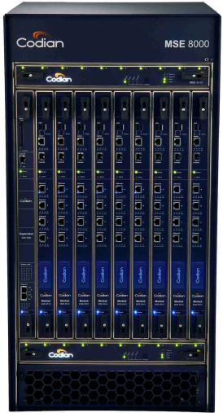
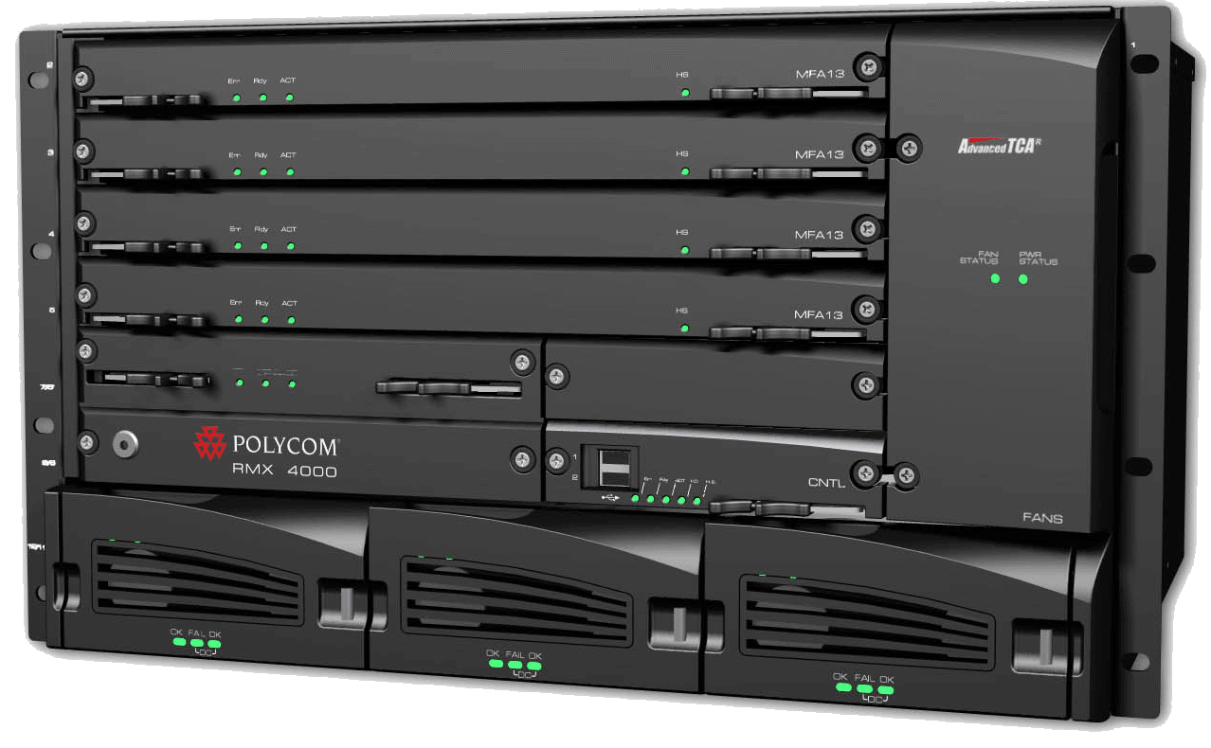
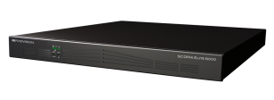
Need 80 HD 720p Ports in a single chassis?
Cisco 19U
Polycom 6U
Radvision 1U
* Chassis may not need to be fully populated
Notes:
Customers wanted an all in one solution. With a display and cart, etc. 55” single or dual solution.

Slide 22
We’re Green
“Hybrid architecture uses
50% less energy per-port
dramatically reducing TCO”

Slide 23
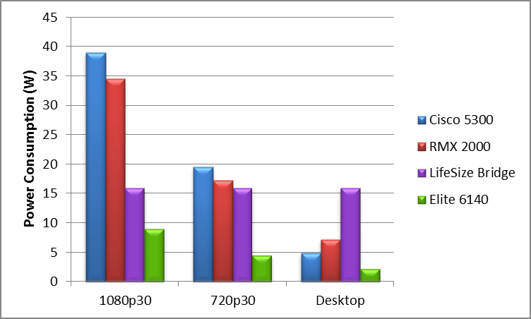
Power Consumption Comparison Hardware Based MCUs

Slide 24
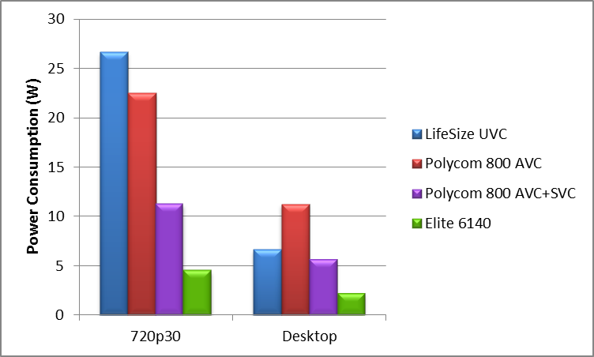
Power Consumption Comparison Software Based MCUs

Slide 25
Scopia Elite 6000 Vs Hardware Based MCUs
Function | Scopia Elite 6000 | Polycom RMX | Cisco MCU 5300 | LifeSize Bridge
1080p60 | ✓ |  |  | 
H.264 High-Profile | ✓ | ✓ |  | 
H.264 SVC | ✓ | Partial |  | 
Mixed AVC-SVC | ✓ |  |  | 
Distributed deployment support | ✓ | H.264 AVC only |  | 
720p ports density per 1U | 80 | 30 | 20 | 16
1080p ports density per 1U | 40 | 15 | 10 | 16
Price per 720p port | $5,500 | $9,300 | $7,200 | $4,000
Price per 1080p port | $7,400 | $18,600 | $14,400 | $4,000

Slide 26
Scopia Elite 6000 Vs Software Based MCUs
Function | Scopia Elite 6000 | Polycom Collaboration Server | LifeSize UVC
720p30 | ✓ | ✓ | ✓
720p60 / 1080p30 / 1080p60 | ✓ |  | 
H.264 High-Profile | ✓ | ✓ | 
H.264 SVC | ✓ | Partial | 
Mixed AVC-SVC | ✓ |  | 
Layout per participant | ✓ | H.264 AVC only | 
Self-see removal | ✓ | ✓ | 
Max conference size w/o cascading | 160 | 60 | 60
720p SVC bandwidth utilization | 512 Kbps | 1.5 Mbps | 

Slide 27
Polycom SVC Limitations
Multi-stream implementation – high bandwidth consumption
720p connection consumes 1.5Mbps
Cannot invite participants – only dial-in supported
No cascading – max conference size is limited to 60
Content sharing – H.264, 720p5 only
No layout control by the moderator
No encryption, FECC, IVR
No recording capabilities

Slide 28
Scopia Elite – A Clear Winner
 | Scopia | Cisco | Polycom | LifeSize
1080p60 Interactivity | ✓ |  | Partial | 
High Profile Bandwidth Efficiency | ✓ |  | ✓ | 
SVC Any network | ✓ |  | Partial | 
High Density 1080p per 1U | 40 | 20 | 15 | 8
High Density 720p per 1U | 80 | 20 | 30 | 8
Cost Effective Price per 1080p port | $7,500 | $18,600 | $14,400 | $4,000

