Slide 1
Proactive Outreach Manager
Customer Presentation
Speaker Name

Slide 2
Presentation Elements
Outbound Business Challenges
The Value for Your Business
Proactive Outreach Manager Overview
Use Cases and Scenario Demonstrations
Proactive Outreach Manager Features
Avaya Professional Services
Avaya Managed Services
Support Advantage
Get Started Today

Slide 3

Customer Expectations vs Company Capabilities
92%
of consumers expect companies to notify them in advance of problems
But…
83%
of organizations cannot deliver a completely blended customer experience automatically and in real time
69%
of consumers expect unique treatment, contacted in a way they want, with offers tailored to them
26%
of consumers claim they are using a wider variety of ways to engage with companies in last 12 mo
Source: Avaya Customer Experience Global Research, March 2014
Customers Expect Personalized, Proactive, Easy Engagement
Notes:
Today customers EXPECT you to notify them in advance of issues and they want personalized treatment. They expect you to serve them through their preferred channel of choice and the variety of ways through which they engage with you in increasing.
HOWEVER, 83% of organizations cannot deliver a blended customer experience (meaning experiences that integrate seamlessly across channels, regardless of channel and from outbound to inbound and vice versa) automatically and in real-time. Think about this: When you reach out to a customer with a collections notice or a service change via email or SMS, are they able to respond via that same channel? Or when the contact you back via a different channel (i.e web chat or voice) does the agent or virtual agent on the other end recognized that they had been reached out to proactively?
Surveys were conducted including:
1,130 business interviews of companies with 1,500 or more employees
8,000 adult consumers 18 years old and up.
49% men and 51% women split among consumers surveyed
54% of business interviews were with Sr. Manager-level and above

Slide 4




Business Challenges
Grow revenue
Keep customers
Lower costs
Reduce risk
Improve productivity
Organizations Face Many Challenges That Must Be Addressed
In Order to Achieve Business Goals While Providing Optimal Customer Care
Notes:
Grow revenues
Get new customers
Up-sell and cross-sell to your existing base
Win back customers
Keep customers
Establish sense of appreciate and value
Proactively care for customer needs
Gather requirements, trends and other relative information
Lower costs
Minimize debt loss
Reduce inbound contact center calls
Optimize workforce activity
Leverage the same system across the organization
Keep on budget
Reduce risk
Adhere to regulatory and compliance requirements
Ensure data security and customer privacy
Reduce complexity of environment and integration

Slide 5
Avaya Outbound Solutions
Delivering the Right Solution for Your Business Needs
$
Increase
Revenue
Improve Customer Satisfaction
Gain Higher Agent Productivity and Lower Costs
Reduce Risk
    Gather campaign insights to acquire/keep customers
    Execute cross-sell/up-sell campaigns
    Improve collections management with early stage collections, payment reminders and fraud alerts
    Provide timely communication of information and updates
    Maximize customer interactions across their preferred channels
    Gather feedback to understand your customer
    Drive higher agent effectiveness with industry leading algorithm
    Combine agentless campaigns with agent based capacity for overall outbound strategy
    Reduce inbound traffic
    by anticipating caller inquiries and automating simple interactions
    Leverage the same platform across your organization with multi-tenancy
    Stay compliant with the latest government regulations (e.g., Do Not Call lists, Opt-out and Opt-in)
    Simplify integration
    with open standards and protocols
    Deploy an integrated solution for all-size contact centers
    Get support from the
    full suite of Avaya professional, maintenance and managed services

Slide 6



Customer Choice of Channel Expanding
77%
72%
64%
59%
23%
20%
40%¹
Self-serve
14%
5%
5%
_{Face-to-Face} in store
_{Social Media}
_{Mobile App}
_{Voice}
Email
Web
_{Chat}
_{SMS}²
_{Video}
Whether they contact you or you proactively contact them,
your customers want to be served through their channel of choice
Sources: Avaya Customer Experience Management Guidebook 2013
¹ The Autonomous Customer 2013, BT and Avaya, Feb 2013
² Webtorials Editorial/Analyst Division
Notes:
When considering how you want to deliver proactive customer care, it is important to understand the channels through which end-customers want to be served. Channels such as email, chat, social media and through mobile applications are growing in use. However, it is important to note that live voice interactions are still the dominant form of customer service. This means that it is important to enable service through the multiple channels that make sense for your business, it is key to consider how they integrate seamlessly - with prior contact history and context carried over - to a voice interaction.

Slide 7


Find Solutions for Your Business
With Avaya you can:
Achieve an integrated outbound dialing and notification strategy
Reduce the time and cost to dial to increase productivity and boost revenue
Improve customer satisfaction and retention
Deploy quickly to achieve business goals faster
Work with an end-to-end provider of UC, Contact Center and Outbound solutions

Slide 8

Evolution of Outbound
From Dialing to Proactive Customer Care across Multi-Channels
Multi - Channel
Proactive Outreach
Collections
Telemarketing
Customer Service
Appointment reminders
Surveys
Loyalty Calling
Automated Agents
SMS
Email
IB/OB Blend
Traditional +
Collections
Telemarketing
Welcome Calls
Winbacks
Outbound Only
Market Growth
Traditional
Collections
Mid-late 1980’s
1990’s
2000’s
Notes:
Outbound has evolved from traditional dialing, strongly leveraged by telemarketing and telecollections companies to inbound and outbound blending where companies took advantage of the technology to increase the productivity of their agents by enabling outbound agents to conduct typically inbound agent tasks and vice versa. Today, outbound is not just about dialing, but about proactive customer care – everything from notifications about upcoming events and service changes to surveys. And it is not just via voice; proactive customer care can take place via two-way SMS and email.

Slide 9
Avaya Outbound Solutions Portfolio
Proactive Outreach Manager
Outbound Contact Express
Proactive Contact
    Avaya’s market leading dedicated outbound dialer
    A leader in global markets
    15th generation platform
    Industry leading voice detection, predictive dialing, system uptime
    Deploy standalone or integrated with call center
    Multiple agent blending options
    Market-leading application for multichannel automated notifications and agent-based dialing
    Runs on Avaya Aura® Experience Portal
    Integrates w/ Call Center Elite & Avaya Aura Contact Center
    Powerful strategy builder
    to escalate between automated voice, email
    SMS text, and agents
    Create custom services with Orchestration Designer
    Turnkey outbound solution
    for small to medium sized contact centers
    Lowers complexity and cost of implementation
    Outbound agent-based campaigns with web-based agent frontends
    and integrated scripting
    Call recording, speech analytics and PBX functionality
Notes:
Avaya currently delivers a number of products in the outbound market.
Proactive Contact is Avaya's high performance industry leading outbound solution primarily targeted to address agent based customer contact. Traditional markets for this solution include Fortune 500 customers engaging in Collections, Telemarketing and Teleservicing.
The Avaya Proactive Outreach offer is a solution supported by Professional Services that integrates Proactive Contact and Avaya Voice Portal as well as the upcoming Avaya Aura® Experience Portal for advanced "agentless" and self-service campaigns. In other words, the Proactive Contact system's strengths are combined with the industry leading Avaya IVR solution for a powerful low-cost alternative to agent-based campaigns.
Avaya has also started the process of migrating to a unified outbound solution. Proactive Outreach Manager (or POM) is Avaya’s next generation outbound platform and runs on the Avaya Aura Experience Portal. Proactive Outreach Manager is currently released as an "agentless" solution but future releases will add agent-based outbound capabilities for all types of outbound strategies. Ultimately, Proactive Outreach Manager will bring all of the power and value that Proactive Contact offers today together with additional channels of outbound communication such as email and SMS. In the meantime, you can sell Proactive Contact with the confidence that the next-generation Avaya Aura® Contact Center will include a world-class outbound solution when your customer is ready to migrate.

Slide 10
Avaya Proactive Outreach Manager
One Unified Solution for Outbound
  A complete solution to create and manage all outbound communications and campaigns, including agent-less multichannel notifications and agent-based dialing campaigns
Predictive
Dialing
  Multiple Expert Calling Algorithms – minimizes the time agents
  spend between each productive contact thereby maximizing their overall productivity
Blending
  Outbound and Inbound Blending – three unique options allow customers to match their business objectives with a blending option. Captures non-productive Agent Ready Time and uses
  it for productive outbound campaigns
Tight Integration with Contact Center
  Runs on Avaya Aura Experience Portal for unified management of inbound and outbound self-service. Integrates tightly with Avaya Call Center Elite and Avaya Aura Contact Center for simplified administration of inbound and outbound.
Notes:
For POM3 differentiators, leverage the strengths of Experience Portal as a platform and an architecture and having great tools such as Orchestration Designer that can now be used to integrate multi-channel outbound with inbound self service. Combine that with single point of administration for agents, pre-built applications like POPS, survey application and the interactive notification app, etc. , a large and growing universe of application developers, single point of contact for customer support, etc. and we have a pretty good story.
POM talking points:
Integrated inbound/outbound automation leveraging Avaya Aura Experience portal as core platform
Sends personalized Voice, SMS, E-mail notifications
Powerful strategy builder to escalate between automated voice, e-mail and SMS
Extensive web services for rapid integration
Based on the industry-leading VXML platform
Lower overall costs of service and improved inbound call volume management

Slide 11






Proactive Outreach Manager
Key Use Cases
Customer Retention
& Win Back
Welcome Calls and Appointment Reminders
Customer Surveys
Fraud Alerts
Increase Revenues &
Cross-selling
Reduce Costs
Today’s Outbound Applications are Dynamic,
Proactive vs. Reactive, Multi-channel, and “Context” Aware
Notes:
Cross-organizational adoption of proactive customer care really took hold in many industries in the mid 2000s. Many organizations now see the value of using outbound from the very beginning of their customer relationship through all stages of that lifecycle.
There are many outbound use cases for activities like collections, appointment reminders, and surveys that are universally considered and used across different industries. Each industry has its own unique set of applications, but let’s look at an example we can all relate to: Appointment Reminders.
This is impactful both from a customer and a business standpoint.
On the customer side: If I have a doctor’s appointment that I scheduled six months ago, I may have forgotten about it. So getting a reminder call from the Doctor’s office can be very helpful and convenient. It would certainly make me appreciate the medical establishment more, and go a long way to creating additional customer loyalty.
On the other side of the coin, the Doctor’s office may find it time consuming and expensive to manually reach out to each of their patients with appointment reminders, but what if they had a cost-effective way to automate that process? They could increase the productivity of their agents, while simultaneously generating customer loyalty.
That’s where Proactive Outreach Manager comes in!

Slide 12






Proactive Outreach Manager
Use Cases by Industry
Financial Services & Insurance
On-boarding
Fraud alert
Payment reminder
Financial Services
& Insurance
Healthcare
Enrollment/Claims
Appt. reminders
Prescription renewal
Healthcare
Utilities
& Telecom
Outages/Restoration
Minutes used
Field service notice
Airline & Travel
Flight status update
Member rewards
Reservation update
Utilities
& Telecom
Airline & Travel
Government
Emergency
Tax reminders
Political campaigns
Consumer
& Retail
Sale alerts
Order/Delivery status
Surveys
Consumer
& Retail
Government
Reach Customers with Information They Value, Improve Profitability
and Collections, and Improve Contact Center Productivity
Notes:
There are many outbound use cases for activities like collections, appointment reminders, and surveys that are universally considered and used across different industries. Each industry has its own unique set of applications.
Utilities and government organizations are often required to inform customers and citizens of particular events, such as upcoming power outages and power restoration, and other events such as snow storms, hurricanes or risk of flooding. Examples include: Local communities and educational institutions leverage outbound for purposes of fund raising, communicating emergency campus or school closings, or schedule changes.
Many organizations in healthcare actively reach out to customers to remind them of upcoming appointments, while utilities make outbound calls to proactively inform customers about maintenance work to avoid incoming complaint calls or to confirm field service appointments to avoid costly truck rolls.
Finally, outbound solutions are also used by many of our Financial and Insurance customers use Proactive Contact from traditional purposes such as collections and cross-sell telemarketing
Examples by industry include:
Finance & Insurance:
Claim Updates
Fraud alerts
Payment Reminders
Balance Update
Automated Renewals
Cross-sell/up-sell
Surveys
Healthcare:
Prescription Alert/Refills
Program Enrollment
Appointment Reminders
Payment Reminders
Out-Patient Updates
Pandemic Warnings
Staff Scheduling Alerts
Post service surveys
Utilities & Telecom:
Field Service Appointment Reminders
Payment Reminders
Service Outage and Restoration Alerts
Emergency Staff Call-Outs
Account Status Updates
Consumer & Retail:
Delivery & Back Orders
Travel Alerts
Collections and Billing Reminders
Subscription Renewals
Contract Renewals
Marketing and Post-Service Surveys

Slide 13
Outbound Use Case: Increasing Revenues
70% of calls are no answer, busy, or answer machine
Predictive dialing passes only “live” contacts to agents
Manual dialing generates 5 live contacts and 1 appointment per hour. Compare with Predictive dialing which generates 3X this.
Outbound communications via Email or SMS enable customers to respond back and generates hot lead
Sales closes 33% of appointments and each deal is worth $2700, so each appointment worth $900
Revenues increased 200% with same number of agents
Challenge | Schedule more security system sales appointments with same number of agents
Current Solution | Manual dialing sales calls
New Solution | Predictive dialing with Proactive Contact Schedule appointments via 2-way SMS with Proactive Outreach Manager (POM)
Results Expected | Increase revenues 200%

Slide 14
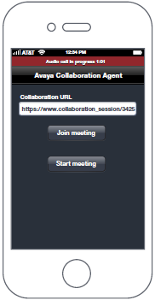
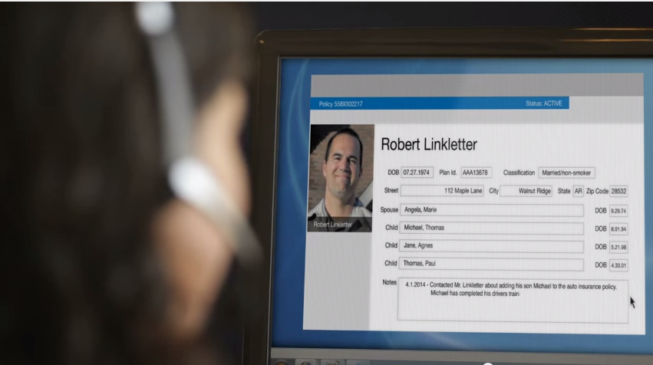
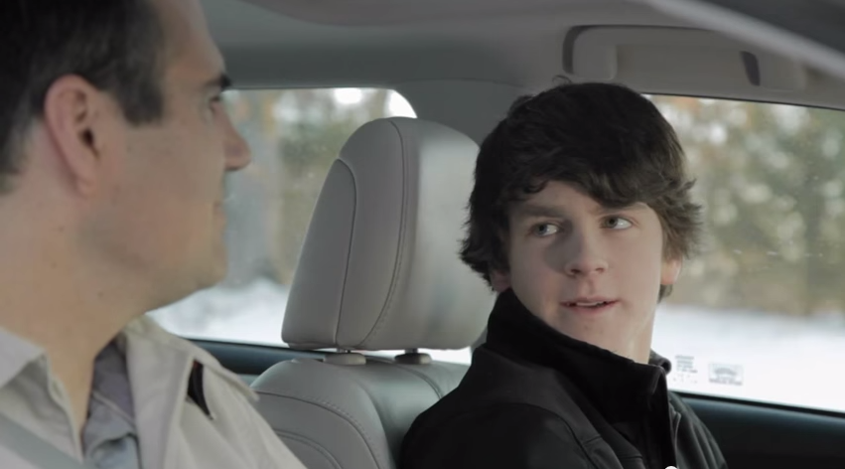
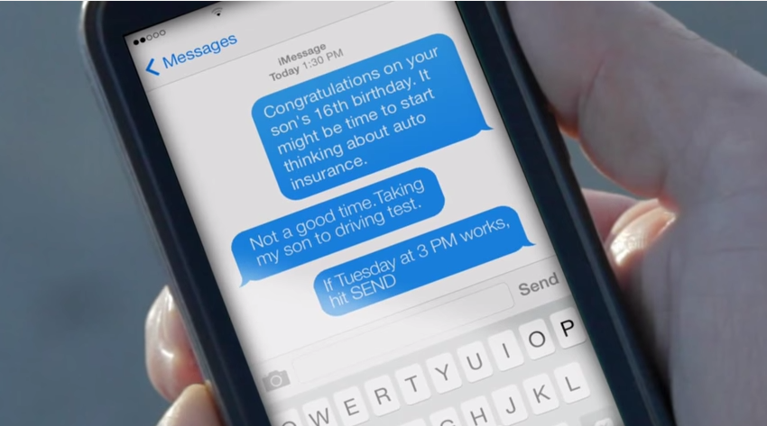
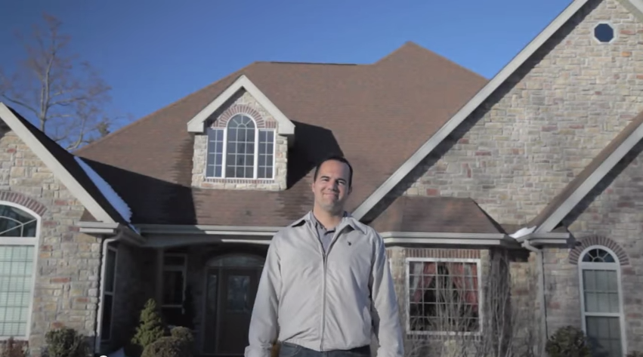
Scenario Demo: Increasing Revenues
Insurance Policy Renewals/Upsell
Customer
Systems
E Mail
Text
Experience
Portal
Proactive
Outreach
Manager
Proactive Notifications
Reports
Voice
Intelligent. Proactive. Superior Service.
Increase Customer Lifetime Value
Notes:
Multichannel Proactive Customer Engagement Video: https://www.youtube.com/watch?v=opRDsVZ2_8M
Script:
As an insurance provider, it is your job to provide insurance services and peace of mind to your customer throughout the various stages of their life; staying with them as provider throughout their life journey (marriage, 1st home purchase, kids, etc). You can create campaigns based on your customer segmentations and upcoming life events, eg. children are about to turn 16 and are learning to drive.
Can start out with email and SMS/text. Enable customers to respond via 2-way SMS/text or email and even incorporate automated callback features to seamlessly enable customers to select callback options
Insurance Text: “Congratulations on your son’s 16th birthday. It might be time to start thinking about auto insurance.”
Customer response via Text: “Not a good time…”
Insurance Text:“If Tuesday at 3PM works, hit SEND”
Callback is scheduled and what was an automated experience delivered by the Insurance company over text seamlessly transitions to an agent-assisted conversation over the phone. The agent has all of the contact history and current coverage information from the CRM database to help the customer update their auto insurance policy to cover their son.

Slide 15
Outbound Use Case: Reducing Costs
Collections
Challenge | Increase “live contact” rate without adding agents
Current Solution | Manual dialing collections calls
New Solution | Predictive dialing with Proactive Contact Unify agent-based dialing with multi-channel notifications via POM
Results Expected | Decrease uncollectable debt 35%
50% of calls result in non-live contact
Predictive dialing passes only “live” contacts to agents Late payment notifications via email/SMS enables customers option to respond via same channel or escalate to call
Manual dialing generated 8 live contacts and 4 promise to pays per hour
Predictive dialing generated 16 live contacts, increasing collections rate 100% to 8 promise-to-pays per hour
Uncollectable debt decreased 35%. Agents were able to contact more past due customers earlier before progressing to unsuccessful late stage processes

Slide 16
Outbound Use Case: Reducing Costs
Great Flexibility
Cost Structure (example)
20,000 contacts at $1.70 = $34,000
30% effectiveness leaves 14,000 contacts that still need to be made
14,000 contacts at $10 = $140,000
Total cost for all contacts is $174,000
If all contacts were live…
20,000 contacts at $10 = $200,000
By using an agentless strategy up front the cost savings is $26,000 for each 20,000 contacts
Item | Live Agent | Agentless
Agent Labor | 70% | 5%
Systems | 10% | 5%
IT Costs | 5% | 2%
Management | 15% | 5%
Cost Per Contact | $10.00 | $1.70
If the cost of a live contact
is $10, then an agentless contact is only $1.70. However, the effectiveness of the agentless contact may only be 30% of a live contact

Slide 17
Outbound Use Case: Improve Service
Improve CSAT and Productivity with Blending
30% subscriber defection rate (96% result from company indifference, service dissatisfaction, or lured away by competitors or friends)
Inbound agents were only contacted after the subscriber had an issue. Agents were forced to be reactive and were not given tools to deliver service satisfaction surveys
Started proactively sending customer care self-service calls for welcome notices, account activity alerts, and service satisfaction surveys
Annual average revenue per user is $600, and they lose an average of 300K customers / year
With POM, defections decreased 10%. $18M in revenues were preserved every year without adding agents. POM delivers further productivity gains via blending, enabling inbound agents to perform outbound tasks and vice versa
Challenge | Increase CSAT rates without additional agents
Current Solution | Inbound Contact Center
New Solution | Proactive Outreach Manager (POM)
Results Expected | Reduce defection rate 10%

Slide 18


Case Study: Improve Service
Major Utility Company
Solution
Avaya Proactive Outreach Manager
Avaya Voice Portal
Intelligent Customer Routing
Problem
Prior call center infrastructure too complex and costly
Need to ensure 5.3 million customers could reach them and be served at all times
Wanted to do more than just answer calls; improve customer service
Business Value
With new capabilities, Xcel has been able to quickly and effectively address customer questions even during high volume periods. Case Study
  With upfront outage notification and callback functionality, reduced inbound calls by 5% during outages
  25% reduction in repeat calls due to high wait times
  Due to cost reduction, was able to reduce reliance on third-party outsources. Better able to control customer experience and only transfer to outsourcer when call threshold reached
Notes:
18
http://www.avaya.com/usa/documents/xcel-energy-white-paper-manage-cust-comm-in-serv-outage-gcc7068.pdf

Slide 19
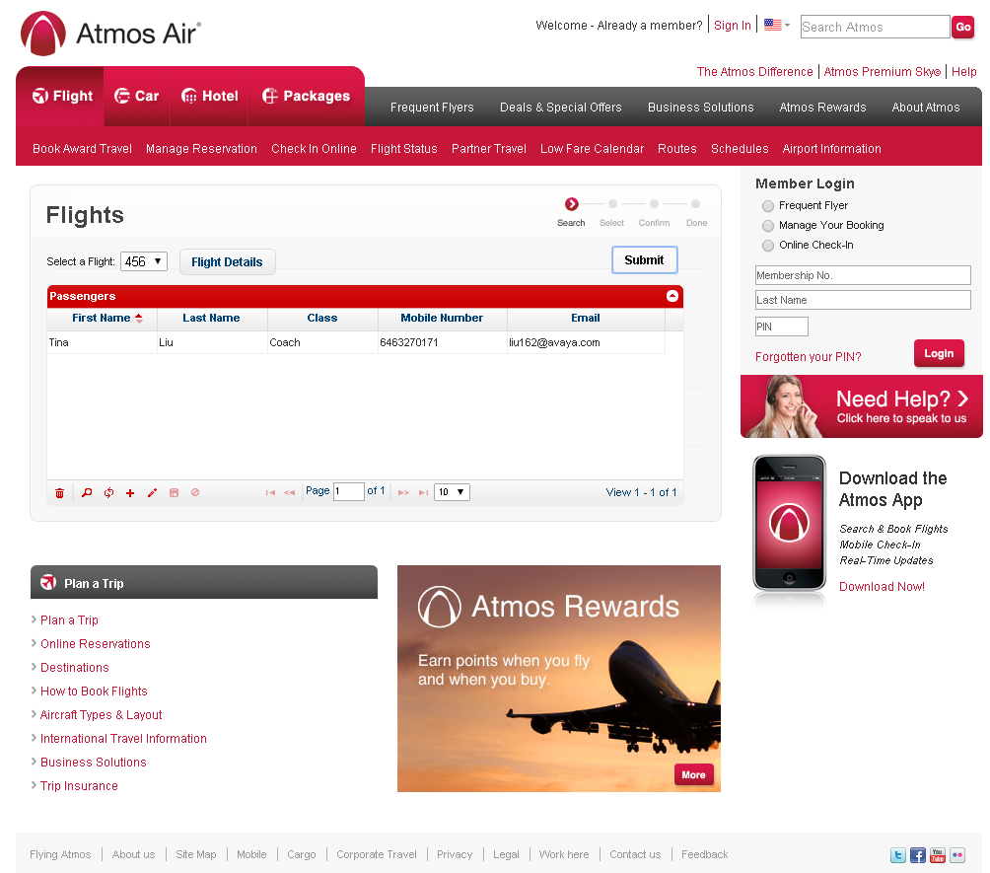
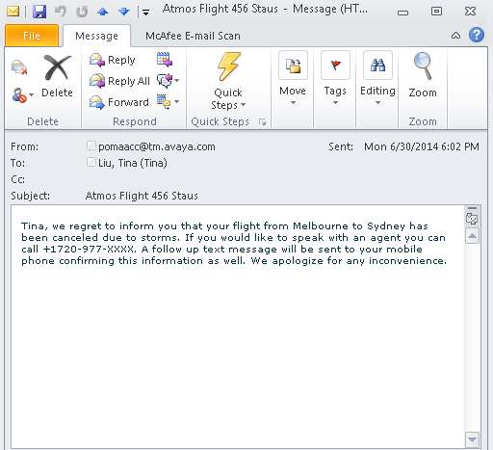
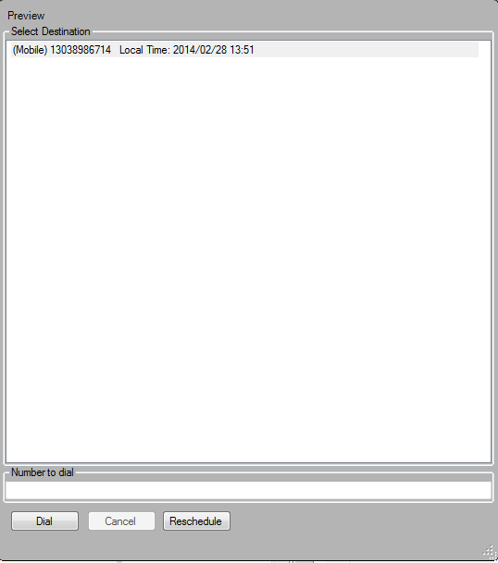
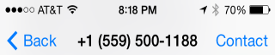

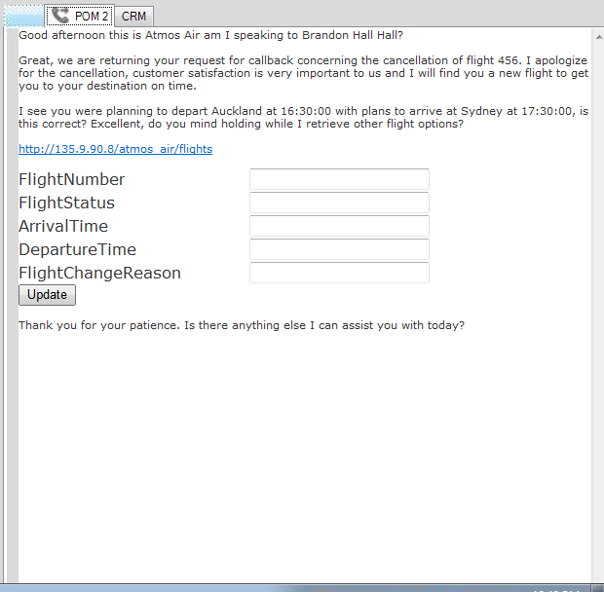
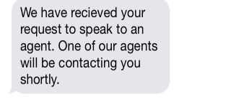
Scenario Demo: Improve Service
Interactive Airline Flight Status Notification
Choice in Proactive Notice
2-Way Interactions
Context & Scripting for Agents
Notes:
Demo can be scheduled and performed live on DemoAvaya (http://www.demoavaya.com/)
Find demo under “Proactive Outreach Manager” and schedule POM Airline Notification Demo
Demo url: 135.9.90.8/atmos-pom
Script:
Imagine being able to provide this level of service to your customers: Allow your customers to keep up to date on travel updates. You can enable them to choose how to receive flight status updates when they want and through the mode of communication that they want. Your customers can manage their profile on your website and opt for email/text notifications. Simultaneously, you can provide an easy-to-use interface for your own business users - customer service teams, marketing, etc – allow them to create campaigns to send out notifications for flight status updates, promotions, local activities, etc. – without heavy lifting from IT
In this example, your customer is kept up to date via email 3 hours in advance of their flight that their flight has been cancelled. They are given the option to call and rebook. One hour in advance of their flight, they also receive a text/SMS. You have the ability to allow customers to respond directly to the text (2-way SMS interaction is a feature of Proactive Outreach Manager 3.0) and you can integrate callback functionality. The best part is that all of this interaction history is recorded and provided to your contact center agents should the interaction be escalated to a voice call.
From your agent’s point of view, they can Preview any calls from the customer and can take advantage of dynamic scripting to aid in their conversation with the customer. You can also feed in CRM information. We integrate with leading CRM solutions.

Slide 20
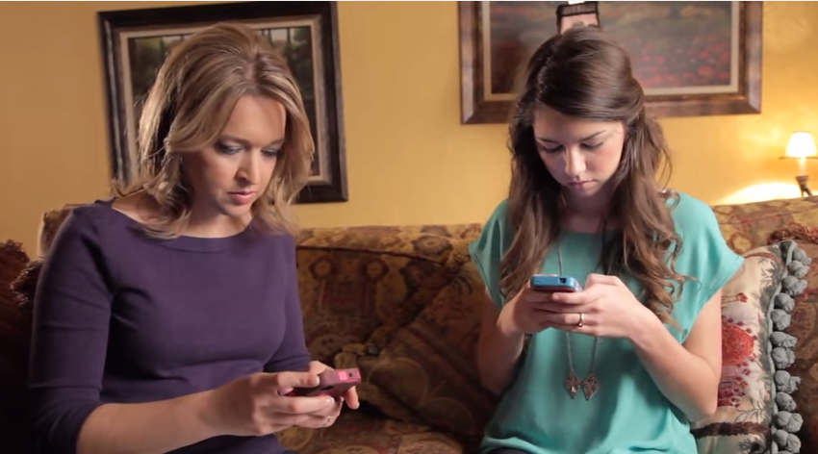

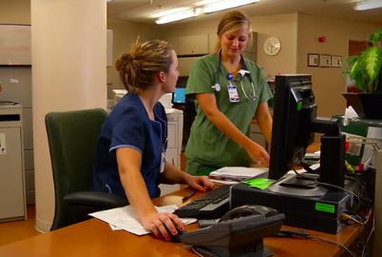
Scenario Demo: Improve Service
Healthcare Appointment Reminder
Customer
Systems
E Mail
Text
Voice
Experience
Portal
Proactive
Outreach
Manager
Proactive Notifications
Click here
for audio demo
Reports
Intelligent. Proactive.
Improve Scheduling Efficiency
Deliver Better Patient Care
Notes:
Video source for images only: https://www.youtube.com/watch?v=EiTXm30hm0c
Script:
Patricia is a busy mom with teenage daughters and is always on the go. Try as she may, she may miss appointments from time to time. Luckily, her doctor implemented an Avaya solution that takes in scheduling and appointment data and proactively notifies patients of upcoming appointments
Receives a reminder via Text
“This is a reminder from Dr <Doctor’s Name> regarding your upcoming appointment on <date> at <time>”. To confirm this appointment, please respond “yes” to this message; to cancel it, respond “no”. Please call 888-555-0897 if you have any questions or need to reschedule.”
Patricia also receives a phone call. Authentication is built into the call to protect her patient data.
“Hello, this is Dr <Dr’s Name> calling for (patient name – first, last). If you are (patient name – first, last), or an authorized representative, please press 1, If not, please press 2
<caller presses 1>
“For security purposes, please enter the patient’s date of birth. For example, if the date of birth is January 7th,1960, you would enter zero, one, zero seven, one nine six zero.”
<caller enters date of birth>
“Thanks! This is a courtesy call to remind you of an upcoming appointment on <month> <day> at <time>. To confirm this appointment, please press 1. To cancel it, press 2. To reschedule it to another time, please press 3. Or, to repeat this message, press 8.”
<caller enters 1>
Thank you for confirming your appointment. We look forward to seeing you then. Have a great day!”
If Patricia needs to call to reschedule, she will be connected to the receptionist at her doctor’s office who will have relevant contact history and patient history available to help Patricia.

Slide 21

Proactive Outreach Manager
Overview
What is it?
A complete solution to create and manage all outbound communications, including agent-based Preview, Progressive & Predictive dialing and agent-less communications through multiple channels
Why does it matter?
Enables organizations to proactively reach out to customers with right information at right time & at lowest possible costs
Improves customer satisfaction and inbound call volume management. Increases collections revenue.
How does it work?
Run with Avaya Aura® Experience Portal to manage inbound as well as outbound
Deploy with Avaya Call Center Elite and Avaya Aura® Contact Center
VMware certified
Powerful strategy builder to escalate between automated voice, 2-way email & SMS and contact center
Extensive web services for rapid integration
Easily create custom services with Orchestration Designer
Stay in compliance with Do Not Call, Opt-In/Opt-Out list management
Campaign
+
Customer Data
Email
SIP
Voice
Proactive Outreach Manager
Text
Live Agent
(only as needed)
Notes:
Solution/Use Cases
Proactive Service
Welcome aboard, card activity, re-fills, fraud alerts, flight changes, appointment reminders, power outage notifications and more
Cost Management
Reduce inbound calls into the contact center with proactive outbound services
Customer Loyalty Programs
Surveys, loyalty program notifications/updates
Collections management
Payment reminders with interactive payment services

Slide 22
Proactive Outreach Manager 3.0.1
Feature Highlights
Agent-based dialing with Preview, Progressive and Predictive Modes for Call Center Elite & Avaya Aura Contact Center (AACC) integrated with agent-less notifications
Skills-based agent inbound and outbound blending
Common Agent APIs for desktop
2-way SMS and Email interactions
Automated skills-based pacing of agent-less multimedia outbound for AACC in addition to Call Center Elite
Campaign and Agent real-time and historical reporting
Call Recording with Avaya WFO
Extensive Web Services
3.0.1

Slide 23
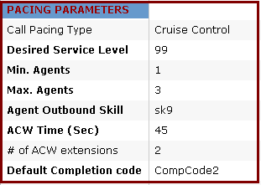
Driving Business Results
Preview, Progressive & Predictive Dialing
Make the best use of your agents’ time
Execute outbound campaigns from one solution that integrates agent-less communications with your choice of agent-based dialing modes
Ensure only live calls are passed on to your agents at 98.9% accuracy
Give your agents more control with the ability to preview customer data on screen before call is placed
Automate service level management with Cruise Control call pacing & comply with nuisance regulations

Slide 24

Driving Business Results
Blended Inbound/Outbound Calling
Improve agent utilization while increasing ability to reach out to customers
Blending Expands Agent Skills and Utilization
Agents presented with outbound calls when inbound volumes are manageable
Provide timely, proactive notifications & reminders
Revenue assurance through collections, appointment reminders and late payment reminders
Use a single agent desktop interface for both inbound and outbound calls

Slide 25
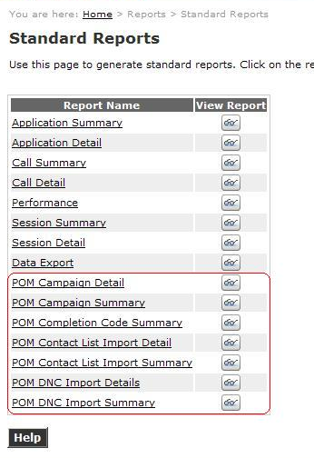
Driving Business Results
Reporting
Improve campaign efficiency and effectiveness with Avaya’s reporting capabilities
Gain real time insight into customer interactions and agent performance data
Gain visibility into campaign activity (e.g., calls remaining, call results, and agent activity)
Real-Time reporting through Campaign Monitor
Post-campaign reporting through Campaign Analyst
Create agent reports on agent work time and performance
Pull reports using intuitive report wizard
Notes:
The reporting feature for POM allows your contact center supervisors to report on the activities of Calling Lists, Campaigns, and Agents, either while campaigns are running or after they are complete. You can gather customer interaction and agent performance data in real time, which the raw data can then be analyzed, configured and displayed in near real-time to supervisors and/or agents via an agent “dashboard”.
This tool also enables your managers or supervisors to select critical campaign statistics they want to monitor and set the Avaya POM to automatically extract this data hourly, daily, weekly, or monthly. The low-cost real-time campaign monitoring visibility allows an unlimited number of workstations to view real-time POM results via the Internet.

Slide 26
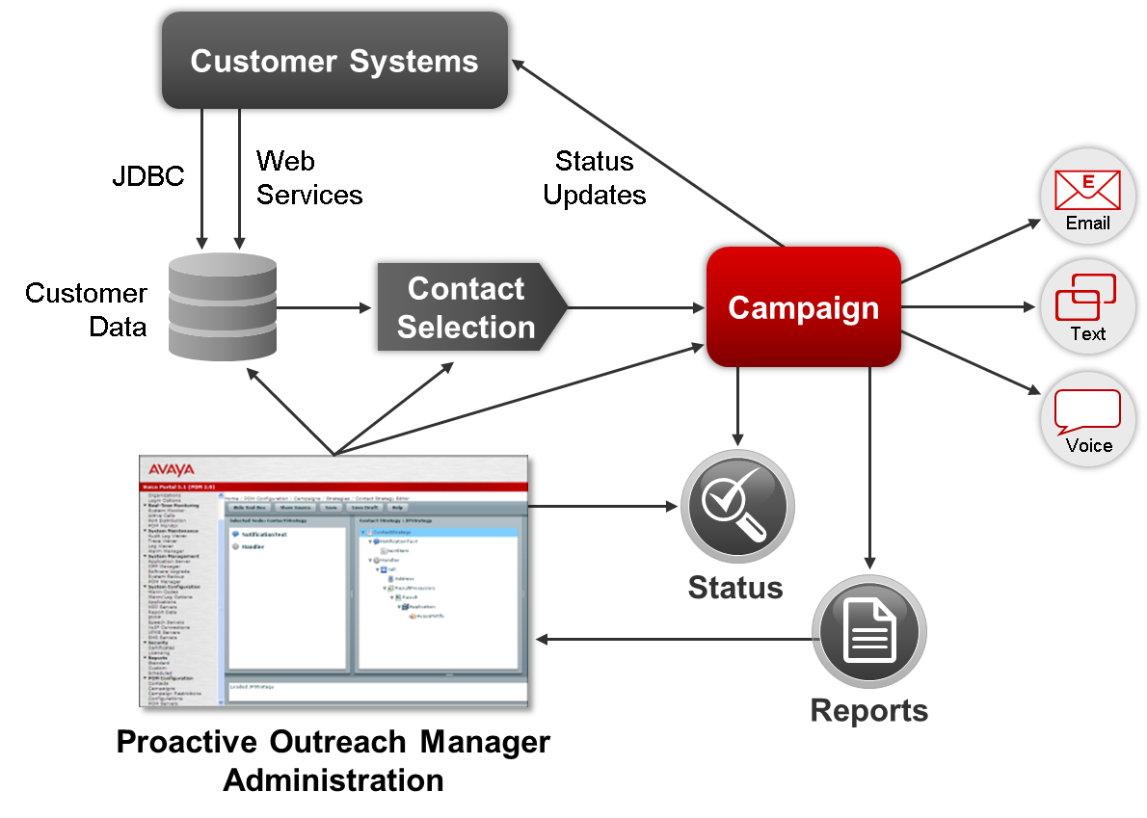
Driving Business Results
Extensive Web Services
Quickly create sophisticated service applications
Extensive web services for rapid integration
Repurpose and reuse existing web applications and resources
Easily create interactive applications that dynamically adjust based on customer triggers, business rules & agent availability with Orchestration Designer

Slide 27
Professional Services for all Your Self Service Needs
Enablement
Optimization
Innovation
Deployment Services
Basic
Standard
All Inclusive
Contact Center Optimization
Advisory Services
Solution Architecture Services
SIP Transformation Services
Network Readiness Assessment
Cloud Transformation Services
Avaya Testing Services
Mobility Strategy Services
Security Assurance Services
Social Media Services
Stress Testing Service
Advanced Software Applications
Performance Monitoring
Project & Program Management
NOTE: Most offers are available as a one-time service or as a subscription service through Avaya Continuous Performance Services

Slide 28
Solutions to Address Unique Business Challenges
Advanced Software Applications
Customer Experience Management Software Connectors
Customer Experience Management Agent Solutions
Automated Self Service
Customer Experience Management Analytics
Enterprise Collaboration
CRM
Reporting
Avaya
3rd party
VDI Agent
Screen Pops
One Touch Video
Web Agent
Customer Routing
Self Service Interactions
Proactive Notifications
Wallboard
Contact Analyzer
Agent Map
Guest Assist
ANS
MAA
Caller ID
Conf. Helper
Application Support

Slide 29
Extend Your IT Staff & Maximize Your Contact Center Investment
Extend Your IT Staff
Avaya Managed Services
Extend Staff skill sets without hiring new employees
Simplify and Increase productivity
Interactive and Customizable management tools and portal
Performance Management & Reporting
Capacity & Availability Management
Maximize Your Investment
Incident & Problem Management
Optimize applications to support changing business drivers
Prepackaged and customizable multi-vendor management solutions
Predictable costs and Opex models
Agreed upon service and performance levels
Configuration Management
Release Management
Avaya Matrix Platform
Notes:
With Avaya Services, you can maximize your investment:
Optimize applications to support changing business drivers
Choose from customizable solutions at a predictable cost with agreed-upon service and performance levels
While many customers see the value of Contact Center Managed Service, some prefer to ease into it. With our new standard offers like Managed Assist and Release Management we are now prepared to do just that.
Managed Assist gives you access to our managed services tools and ITIL offers but provides more customer control and more customer accountability.
Release Management will distribute software, including license controls across the network. Proper software control ensures the availability of licensed, vendor-tested, and version-certified software, which functions as intended when introduced into the existing infrastructure. This offer is eligible for all support Avaya products and software.

Slide 30
Ongoing Maintenance with Support Advantage
Protect your Contact Center solution with global support services designed to give your business maximum flexibility and uptime
Top Business Issues & Problems
Benefits of Support Advantage
Technical Capabilities
Inability to support complex communications and resolve issues quickly in integrated environments
Designed to support complex solutions with integrated holistic support
Lower
TCO
Unattractive TCO for products/ services and little flexibility, minimizing ability to ensure proper coverage and meet budgets
Provide a lower product and services TCO than competitors
Lack business continuity with quick and easy access to support and resources
Maximize your solution uptime with innovative technology and tools
Business Productivity
Notes:
Support Advantage, Avaya’s holistic maintenance model, is designed to address Top Business Issues and Problems:
Technical Capabilities: The ability to support for complex communications and infrastructures and quickly resolve issues in integrated environments.
Lower Total Cost of Ownership: Ensuring products + services to have attractive TCO and are flexible to ensure proper coverage and meet budgets.
Business Productivity: Ensuring business continuity with fast and easy access to product support and resources.
Protect your Avaya enterprise communications solutions with standardized global support services designed to give your business maximum flexibility and uptime.
With Support Advantage, you will get lower TCO than the competition and ensure your business solutions remain up-to date with faster response times through features such as web ticketing. You will have easy access to Intellectual property, engineers, monitoring, and web-based tools to help ensure maximum uptime.

Slide 31
Why Avaya Outbound?
Service
and Support
Best in Class Platform
Market
Leadership
    Proven reliability and award winning service
    99.9+% documented uptime over 8+ years
    Global presence in over 90 countries
    A solution that addresses your needs
    15th generation solution driven by our customers
    Industry leading call detection and predictive dialing fully integrated with outbound notification
    Relentless focus on agent productivity
    A leader in contact centers and outbound
    Recognized global leader by industry experts
    End-to-end provider of UC, Contact Center & Outbound solutions
    Over 2,000 systems installed worldwide
“Best In Class” Solutions That Enable You to Deliver
a Superior Customer Experience at the Lowest Cost
Notes:
Proactive Contact is a market leader in outbound for both the North America and the Europe, Middle East and Africa markets. It's been a market leader for 25+ years with more than 2000 systems installed worldwide.
A product only achieves long term market leadership if it provides industry leading functionality and offers real business value, combined with an undisputable Return on Investment. How did we achieve and keep our market leadership? The answer is simple: Listening carefully to our customers, we provided the functionality they required to run their contact centers efficiently and cost effectively and that in return provides the highest possible return on their investment.
Proactive Contact 5.0 adds new functionality to its already robust feature set to continuously better support our demanding outbound customer base.
Proactive Contact provides proven reliability and with that unrivalled system availability. Research based on 8 years of Customer Support records shows that our installed systems have an average uptime of over 99.9%.
Lead with Avaya’s legacy of outbound market leadership
25+ years as #1 or #2 in the industry
High profile, Fortune 500 customer list, most with multiple Avaya dialers
Discuss product development philosophy
We deliver features that deliver high ROI and low TCO
Call detection, Dialing algorithms, Blending, Reliability
Discuss Avaya’s outbound strategy & roadmap
Industry leading Proactive Contact evolving to POM
Diagnose before we prescribe
Understand customer’s call volumes, talk times & value of a call
Avaya has an impressive pedigree in outbound with over 25 years of being #1 or #2 in the industry, and our customers include the top Fortune 500 companies in virtually every vertical market segment. It is critical to use this legacy to establish credibility early in the sales process, so that the audience will understand when we talk about our product, that our approach has propelled us to the perennial role of market leader.
When we do move onto discussions about our product, it is important to stress that we have focused our development efforts on delivering features & functionality that translate directly into Return on Investment. While our competitors like to “sell the sizzle” of pretty user interfaces and other bells & whistles, we “sell the steak”, because we have incorporated key functionality into our product that can’t be matched by our competitors.
In summary, the four technological differentiators of Proactive Contact that drive ROI are: Superior Call Detection, Sophisticated Dialing Algorithms, Multiple Blending Options and Platform Reliability.
In addition, we should always discuss our outbound roadmap and strategy, so that customers can see that as the perennial market leader, Avaya has a sound strategy for outbound not only today, but as contact centers continue to evolve into the next generation.
Finally, we all know that listening is a fundamental component to any sales engagement. But even more than that, particularly for outbound, we must understand some core calling dynamics of a customer’s outbound operation before we can propose a solution. Understanding a company’s call volumes, talk times and values associated with a successful call – a sale or a promise to pay for example, can help feed an ROI based proposal.
Thank you for your time slide
Today we’ve only touched on Avaya Proactive Contact…
We have a team of specialists to discuss this in much more detail…specialist team of consultants…
3 points about Avaya – Innovators, we’re #1, best customer service. Real simple – reemphasis Why Avaya? Leadership in core markets and industry recognition
#1 in market, #1 outbound, unifed approach
Support JD Powers
Innovation
#1 call center, UC, maintenance service, messaging, telephony system
Virtual agent, integration to Avaya Voice Portal

Slide 32
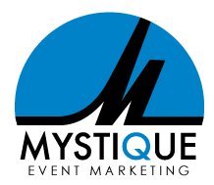


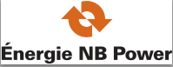

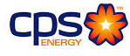
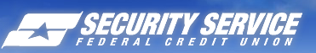
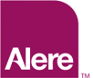
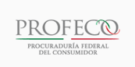
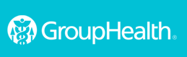

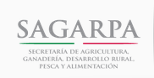


Companies Worldwide Rely on Avaya Outbound Solutions
Notes:
Outbound Solutions include Proactive Contact, Proactive Outreach Manager and Outbound Contact Express
Customers span all industries/verticals including Financial Services, Healthcare, Utilities and Government

Slide 33

Get Started Now
Customers are asking for:
Multimedia automated outreach solution, integrated
with the contact center
Best-of-class features
  Call classification, multimedia with contact strategies, flexible campaigns, in-depth reporting
Open, standards-based, easy to integrate with other systems
Topmost data security and full control of operations
Above all – a trusted name that helps solve business problems
Avaya Proactive Outreach Manager
Unified market-leading agent-based technology with automated multichannel

Slide 34




Transform Your Business
One Great Interaction at a Time

